Slide 1
u.s. Covid-19 data by county level with elasticsearch
Start
MENU
Analysis
CIS 3200-02 DATA PROCESSING & ANALYTICS (Fall 2022)
ANALYZING

Slide 2
HeLLO!
Start
MENU
Analysis
CIS 3200-02 DATA PROCESSING & ANALYTICS (Fall 2022)

Slide 3
TABLE OF CONTENTs
Objectives
Types of Analysis
01
02
Challenges
OUR TEAM
03
04
Start
MENU
Analysis
CIS 3200-02 DATA PROCESSING & ANALYTICS (Fall 2022)
Provides a list and explanation of the key lessons we used for this project.
A brief layout of the key points throughout this presentation.

Slide 4
INTRODUCTION
Start
MENU
Analysis
CIS 3200-02 DATA PROCESSING & ANALYTICS (Fall 2022)
Our data set: “Covid-19 US County JHU Data & Demographics” 2020-2023
Data set size: 309MB
The dataset contains daily updated numbers of reported cases & deaths

Slide 5
objectives
Start
MENU
Analysis
CIS 3200-02 DATA PROCESSING & ANALYTICS (Fall 2022)
Identify areas with the most Covid cases and most deaths
Analyze which counties within the U.S. are impacted the most
Create visualizations to show the impact of Covid-19
Map out geographical areas to visualize Covid-19 in the U.S.
Use Regression Analysis

Slide 6
Type of analysis?
Start
MENU
Analysis
CIS 3200-02 DATA PROCESSING & ANALYTICS (Fall 2022)

Slide 7
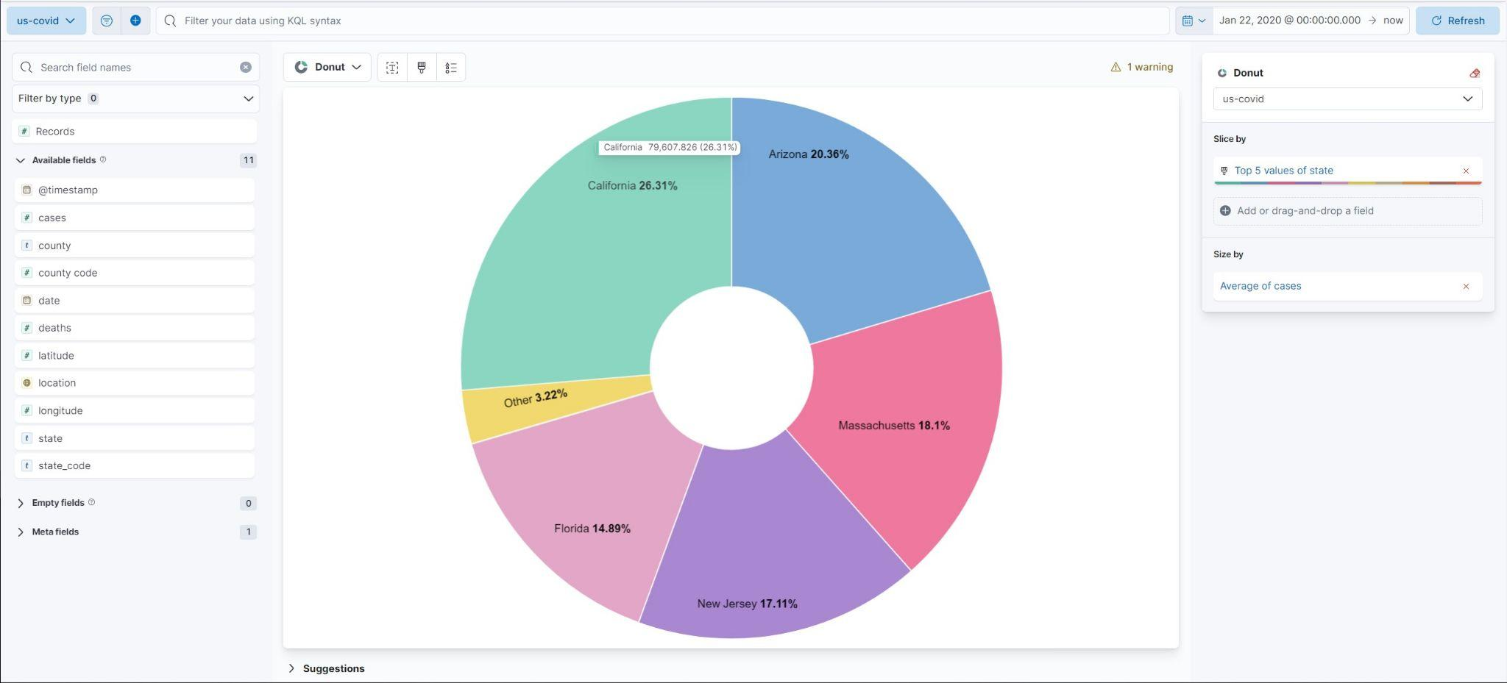
Pie chart
Start
MENU
Analysis
CIS 3200-02 DATA PROCESSING & ANALYTICS (Fall 2022)
Top 5 average number of cases by state.
California - 79,607
Arizona - 61,616
Massachusetts - 54,764
New Jersey - 51,772
Florida - 45,042
Notes:
William
This pie chart visualizes the top 5 average number of cases by state. This information is relevant because from the pie chart we can see the states that are being impacted the most since 2020.The number of cases are being updated daily and these states are seeing the largest amount of average daily cases.

Slide 8
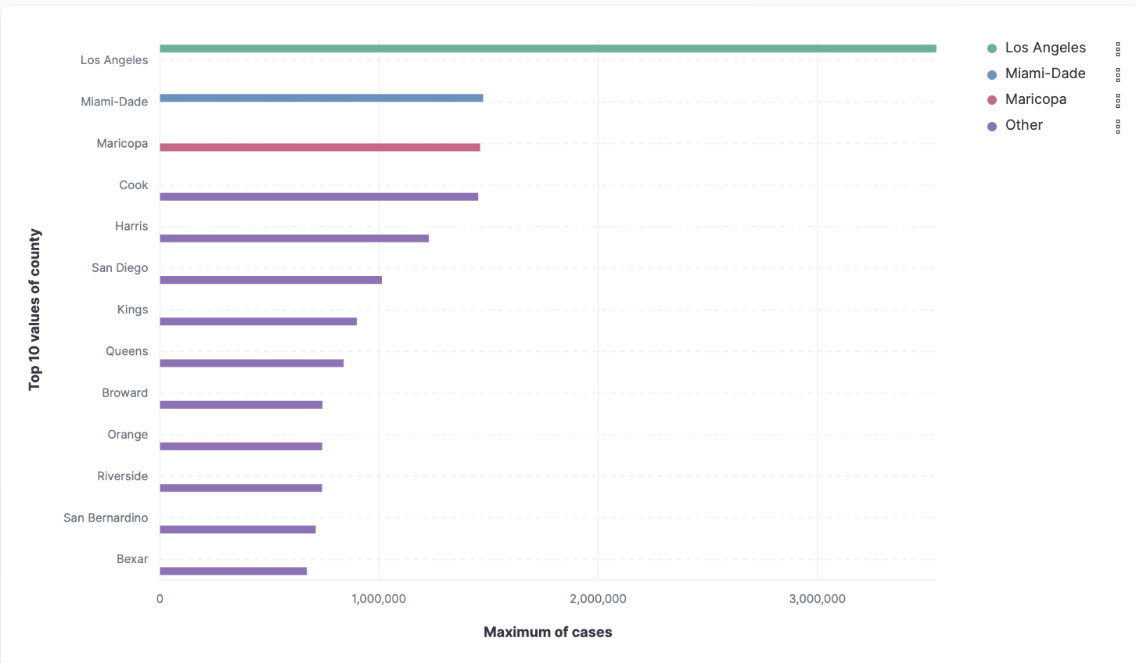
Horizontal Bar
Start
MENU
Analysis
CIS 3200-02 DATA PROCESSING & ANALYTICS (Fall 2022)
Top 5 Counties with the most number of cases
Los Angeles: 3,542,744
Miami-Dade: 1,474,684
Maricopa: 1,461,222
Cook: 1,452,038
Harris: 1,226,840
Notes:
William
T

Slide 9
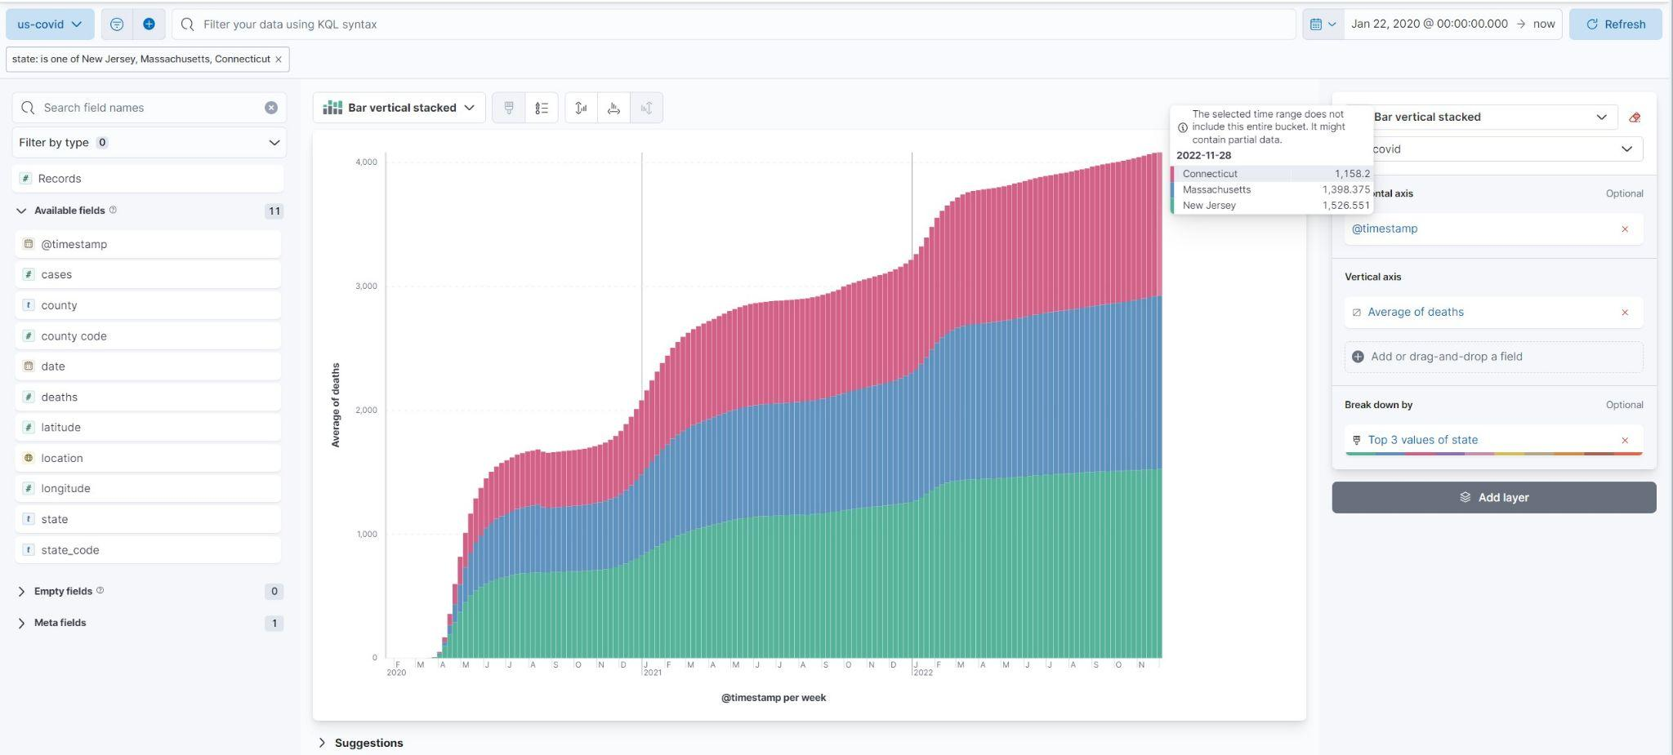
Vertical bar stacked chart
Start
MENU
Analysis
CIS 3200-02 DATA PROCESSING & ANALYTICS (Fall 2022)

Slide 10
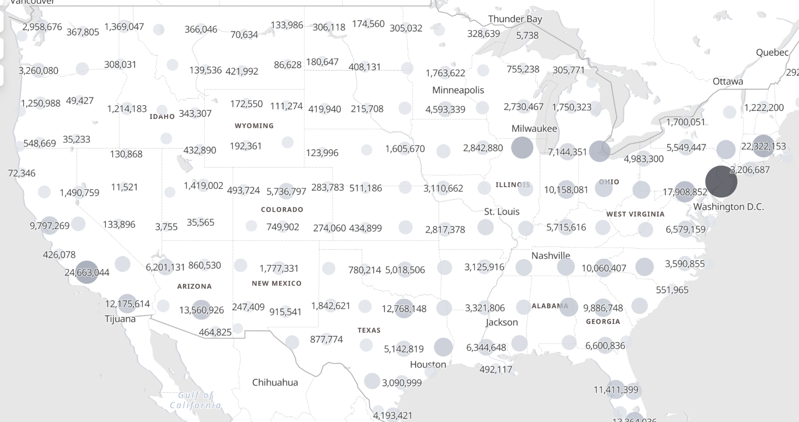
Geo visualization
Start
MENU
Analysis
CIS 3200-02 DATA PROCESSING & ANALYTICS (Fall 2022)
Number of COVID-19 Deaths County-Level

Slide 11
Challenges
Start
MENU
Analysis
CIS 3200-02 DATA PROCESSING & ANALYTICS (Fall 2022)
Using Data Visualization & Machine Learning in Elasticsearch

Slide 12
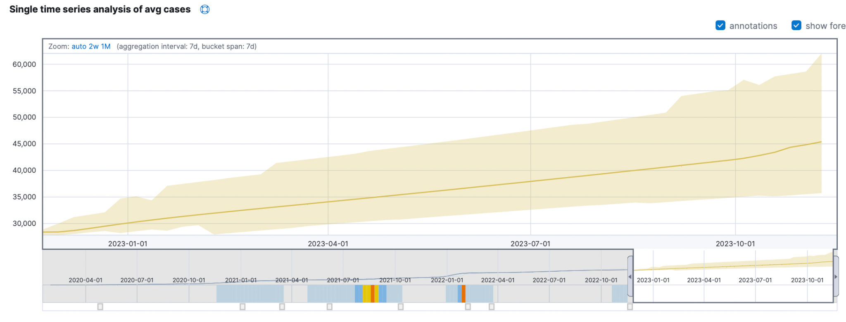
Forecast using Anomaly Detection (AVERAGE CASE)
Start
MENU
Analysis
CIS 3200-02 DATA PROCESSING & ANALYTICS (Fall 2022)
Latest Data : Fr0m Jan 22 - Nov 23, 2022 - 29,294.08
Predicted Average Cases : Nov 15, 2023 - 45768.134 (56.24%)
MAX: 64,805.96 MIN: 35,699.971

Slide 13
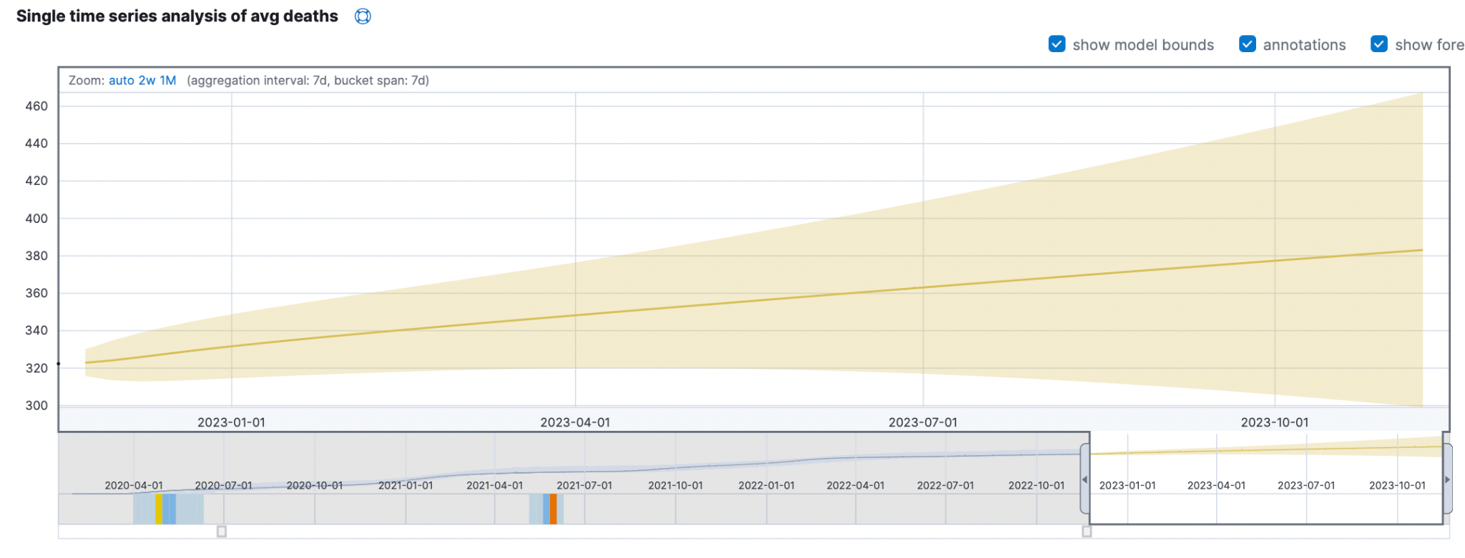
Forecast using Anomaly Detection (AVERAGE Death)
Start
MENU
Analysis
CIS 3200-02 DATA PROCESSING & ANALYTICS (Fall 2022)
Latest Data : Fr0m Jan 22 - Nov 23, 2022 - 322.353
Predicted Average Death : Nov 15, 2023 - 384.166 (19.18%)
MAX : 470.748 MIN: 297.583

Slide 14
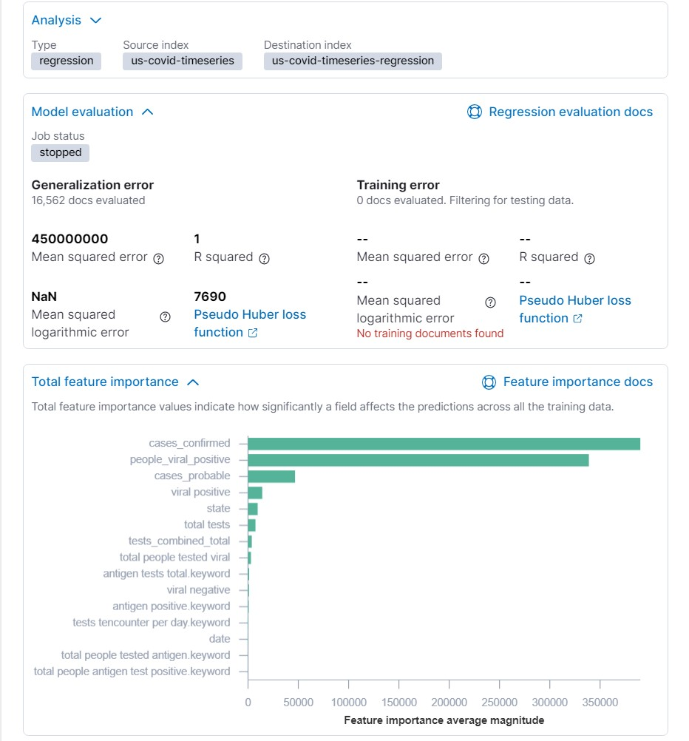
Start
MENU
Analysis
CIS 3200-02 DATA PROCESSING & ANALYTICS (Fall 2022)
Using Regression analysis through Machine Learning
Steps:
Used probable_cases as our dependent variable
Excluded erroneous
Encountered calculating accuracy error (RMSE)
Unable to correctly process and analyze data.

Slide 15
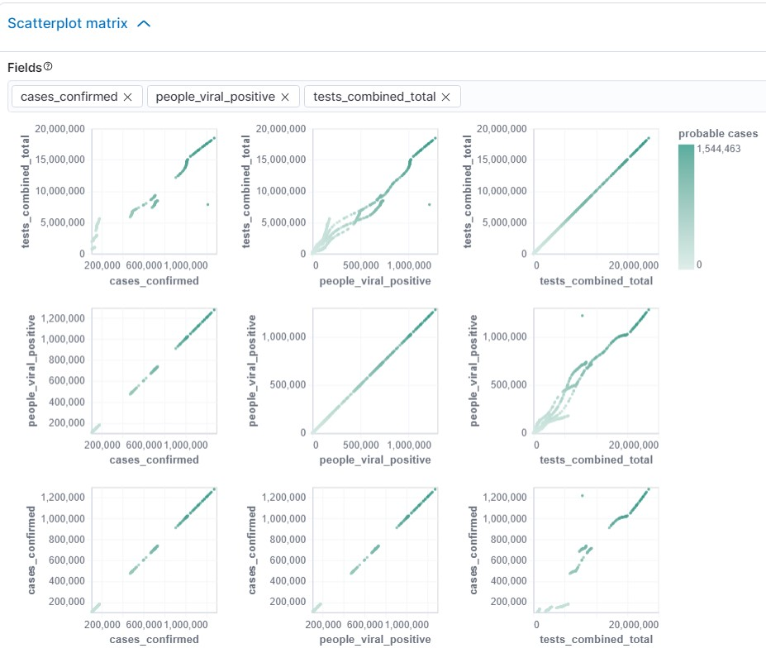
Using Regression contd.
Start
MENU
Analysis
CIS 3200-02 DATA PROCESSING & ANALYTICS (Fall 2022)
Selected fields for correlation analysis (cases_confimed, people_viral_positive, tests_combined_total)

Slide 16
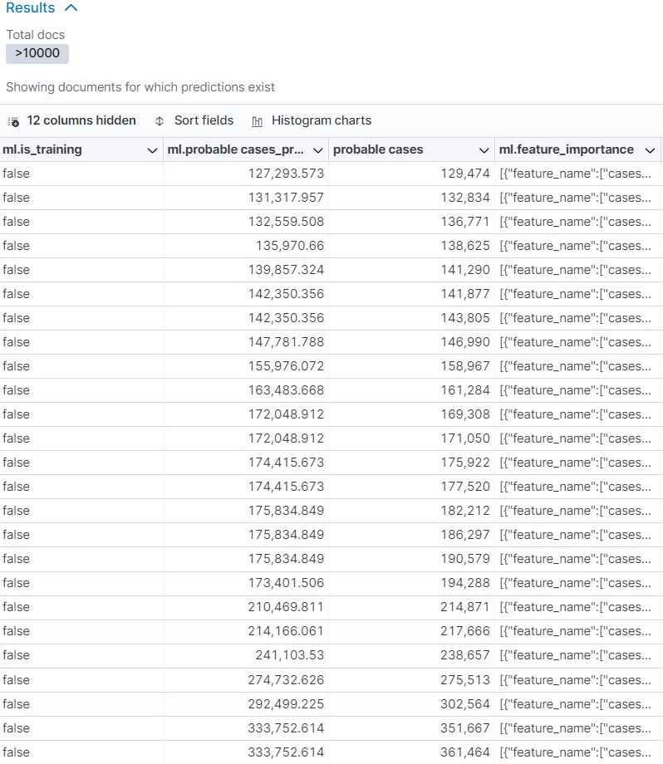
Start
MENU
Analysis
CIS 3200-02 DATA PROCESSING & ANALYTICS (Fall 2022)
Using Regression contd.
Results showed prediction values vs. actual values.
Mean Squared Error (MSE)
Difference squared between predicted value vs. actual value, then sum of all squared values divided by count of observations

Slide 17





Start
MENU
Analysis
CIS 3200-02 DATA PROCESSING & ANALYTICS (Fall 2022)
Clever I Lemus
Jung Tae Cha
Luis Rodriguez Robin Huynh William Gomez
-Undergraduate in CIT
-Undergraduate in CIS
-Undergraduate in CIS
-Undergraduate in CIS
-Undergraduate in CIS

Slide 18
THANK You!
Start
MENU
Analysis
CIS 3200-02 DATA PROCESSING & ANALYTICS (Fall 2022)
-DATAset source and link: John Hopkins University and https://www.kaggle.com/datasets/headsortails/covid19-us-county-jhu-data-demographics
-Github Link:
-H/w Experimental Specifications: increased data upload size for machine learning
H/W Specifications: GitHub:

Slide 19
Start
MENU
Analysis
CIS 3200-02 DATA PROCESSING & ANALYTICS (Fall 2022)
Questions?

